Slide 1
Drowsiness Detection
Problem Statement – detect drowsiness from a video stream in real time.
Approach – convert videos to images and study features of images.
Pre processing – Feature extraction from video using OpenCV. 4 features are extracted. 4 more will be created using standardization.
Discretization – Find out the best no. of bins for each feature using K Means Clustering. Then use WCSS criteria or use Grid Search for a manual brute force identification of no. of bins to use.
After fining out bins, use KBinDiscretizer from sklearn on each of the 8 features.
Then use algorithms to train on the data and predict. KNN doesn’t need discretization. Trees can also avoid discretization if regression trees were implemented.
Algorithms used – KNN, Gradient Boosting, XGBoost, Bagging, Boosting

Slide 2
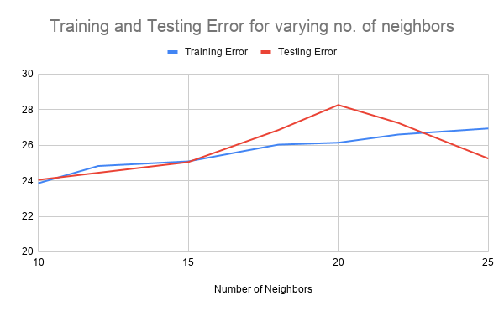
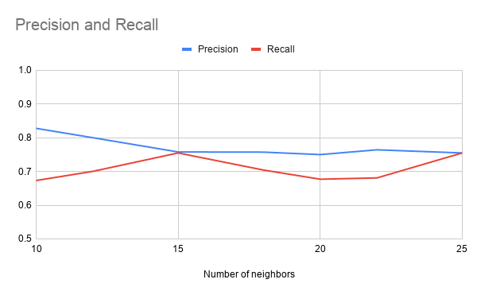
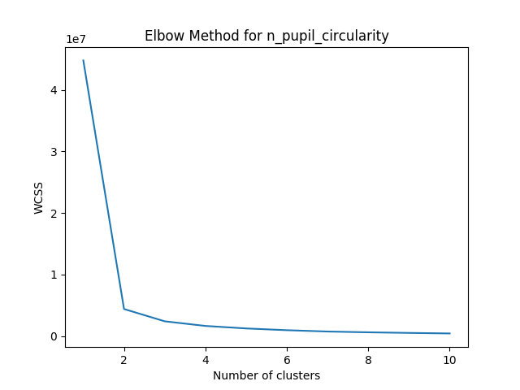
Drowsiness Detection
Features are standardized to avoid not being able to generalize and react to new faces.
Outliers can be dealt by using voting along with neighbors for each classification.

